Slide 1

Sci-Sub
Leading Innovation in Submersible research
By: Danny Maurer

Slide 2

What were going to cover
Motivation
Inspiration
Idea
Previous Work
Product
Development
Demonstration

Slide 3
Motivation
Take advantage of largest major on campus
Join forces with physical science departments
Create a computer system
Take data
Wide focus
Allow for iterations

Slide 4
Inspiration
Select picture to watch trailer

Slide 5
Idea
Underwater Instrument
Goals
Cost effective
Custom for school use
Develop software and networking

Slide 6
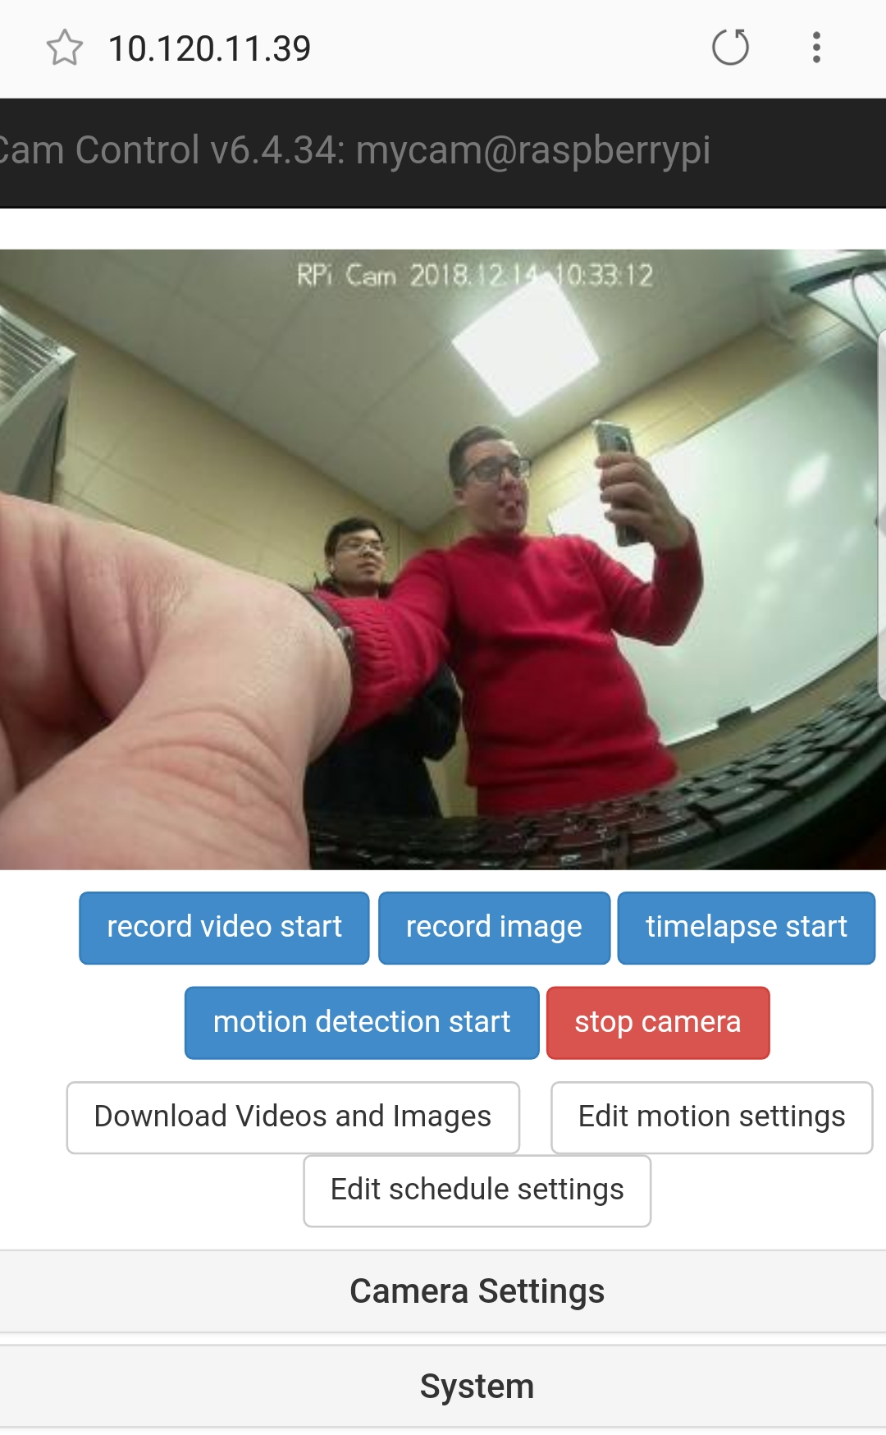
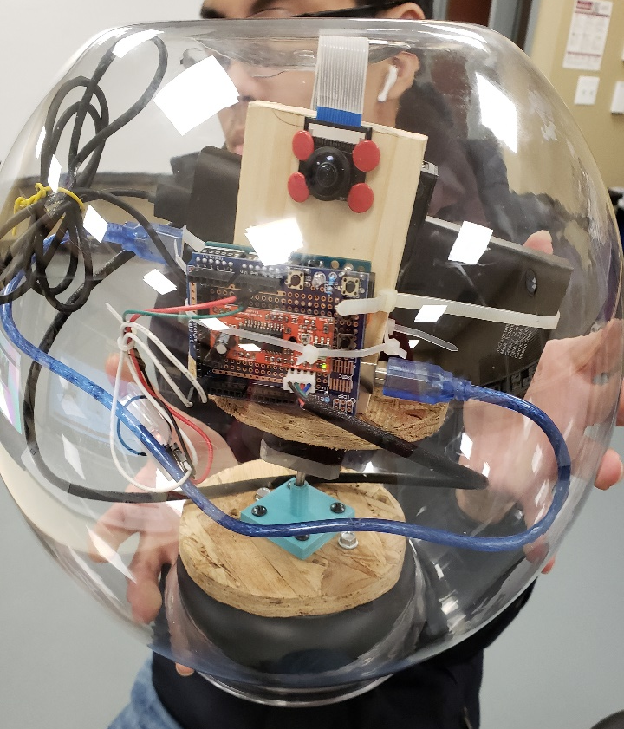
Previous Work - DomeZone

Slide 7
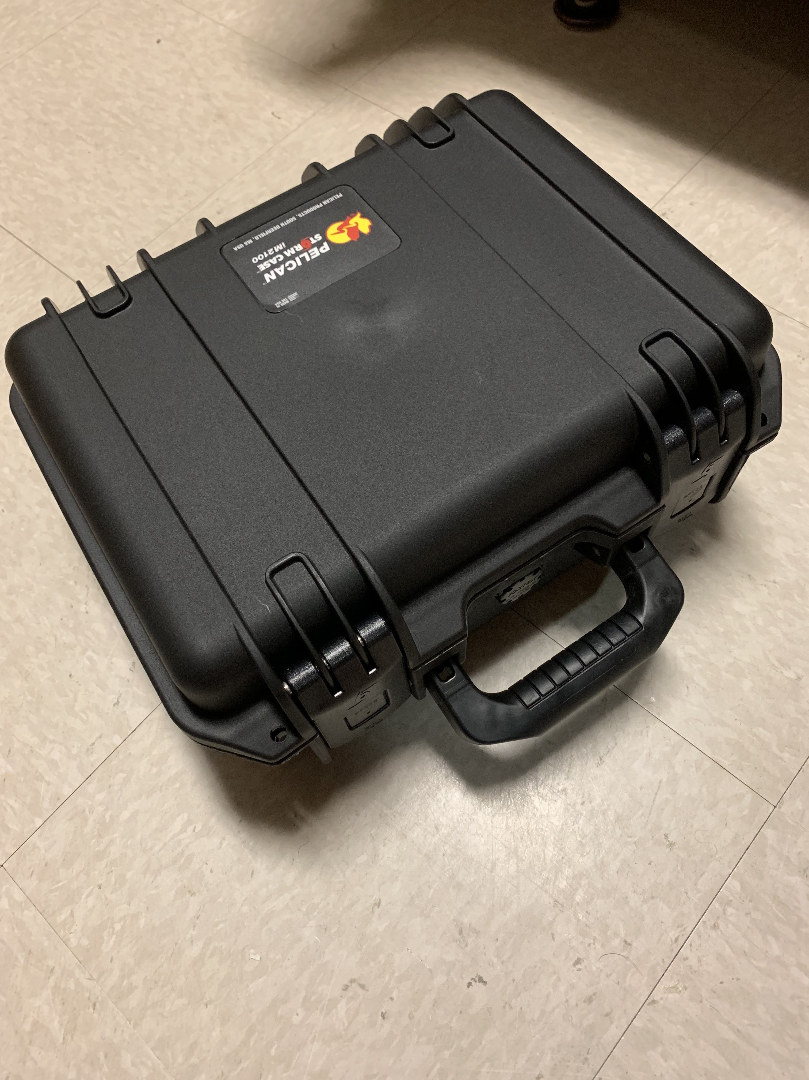
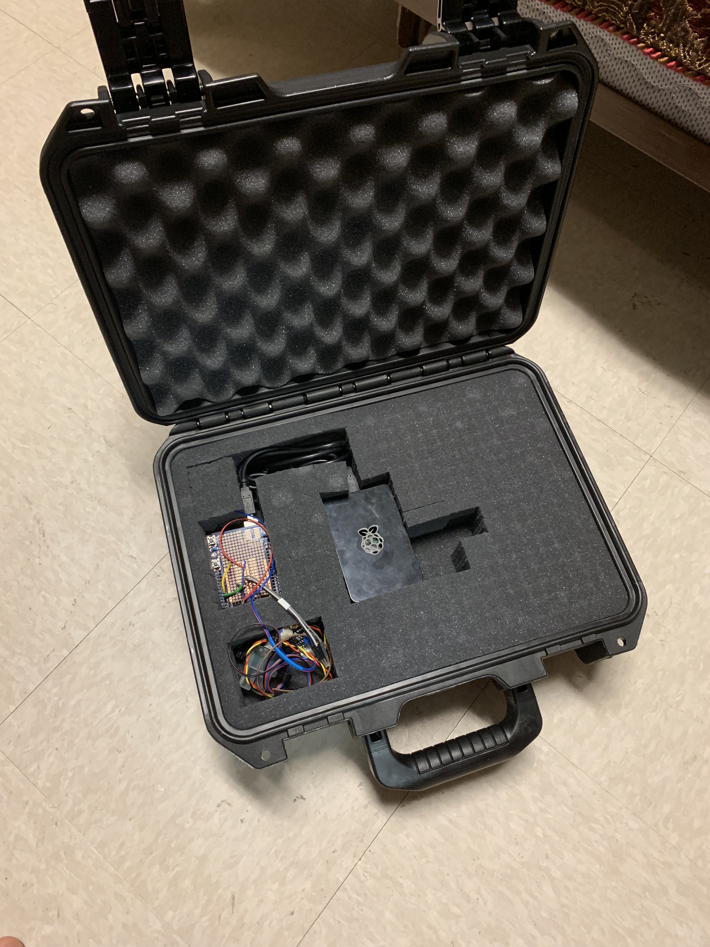
Product

Slide 8
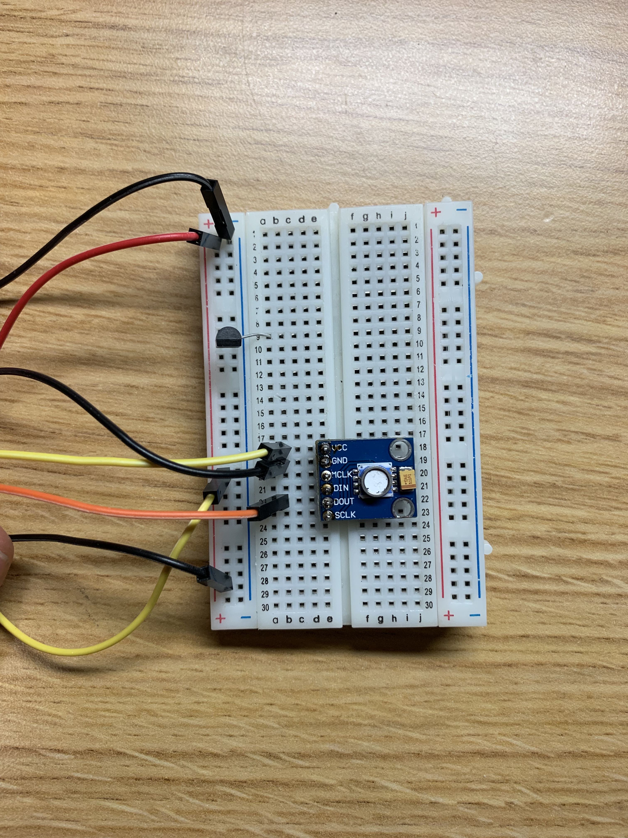
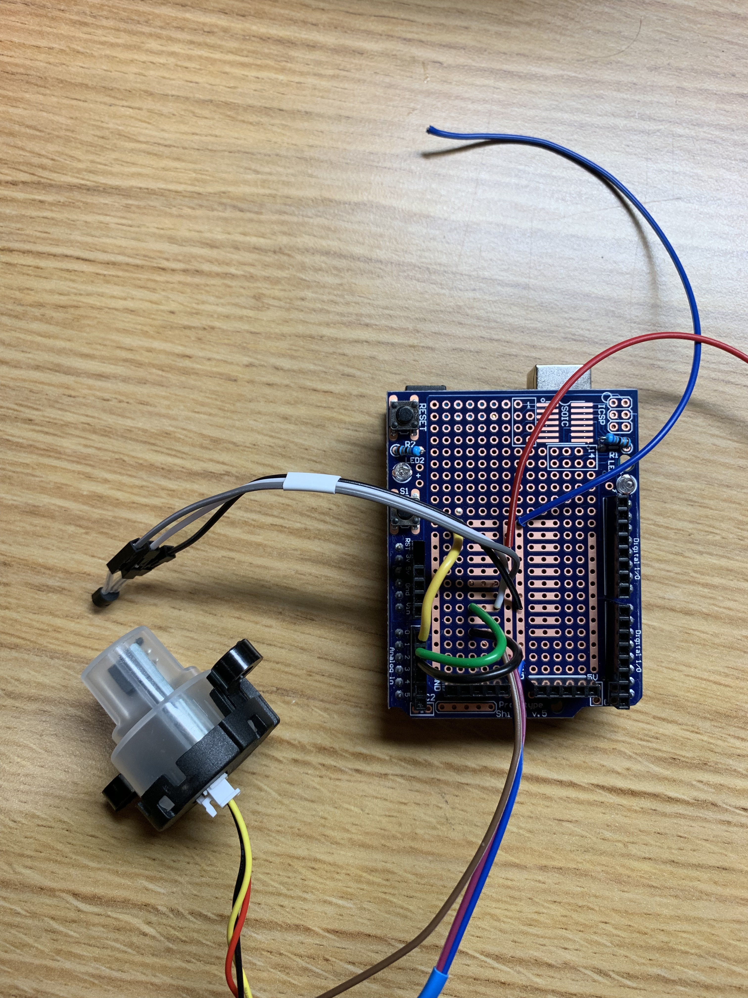
Development - Hardware

Slide 9
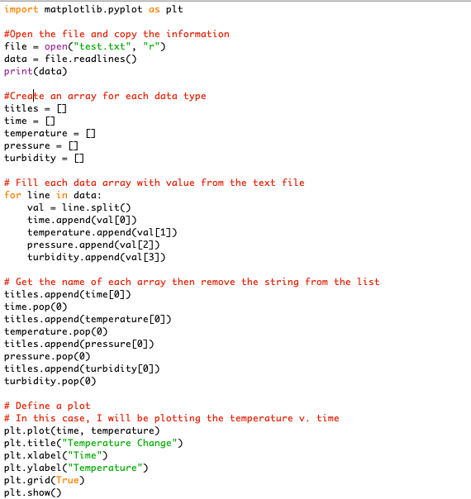
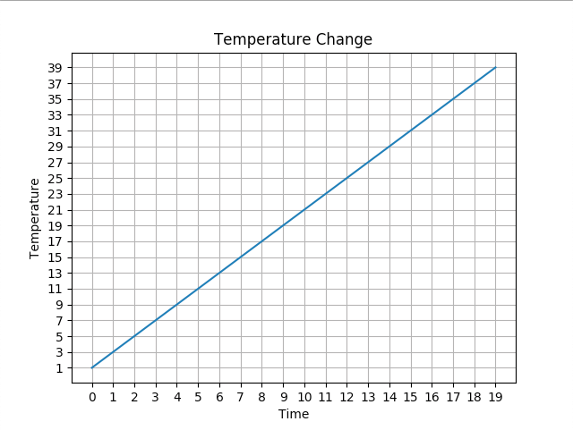
Development - Software

Slide 10
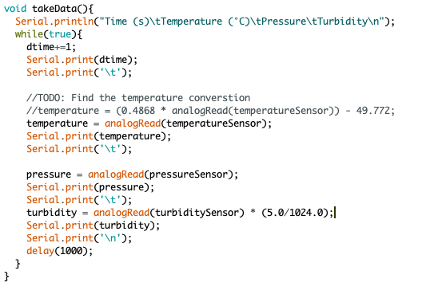
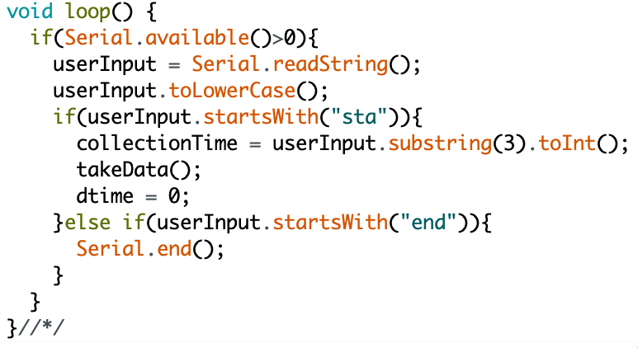
Development - Software

Slide 11
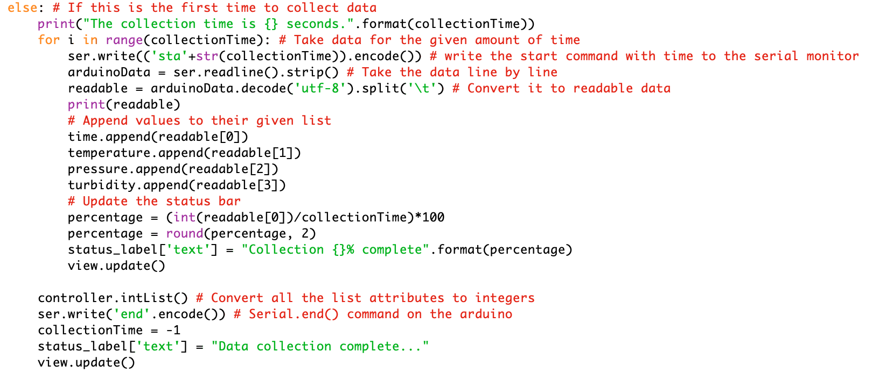
Development - Software

Slide 12
Demonstration

